Slide 1
The 5 Laws of Social Networking
Jonathan R. Whitehead
Jon@whiteheadlawllc.com
http://whiteheadlawllc.com
October 7, 2010
CCEM
Tan-Tar-A

Slide 2
Social Networking

Slide 3
BE THERE.
Law1:

Slide 4
Be there because your customers are there.

Slide 5
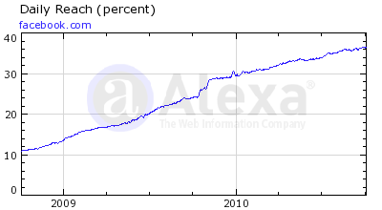
Over 30% of Internet Users each day.
Source: alexa.com; 10/6/2010

Slide 6
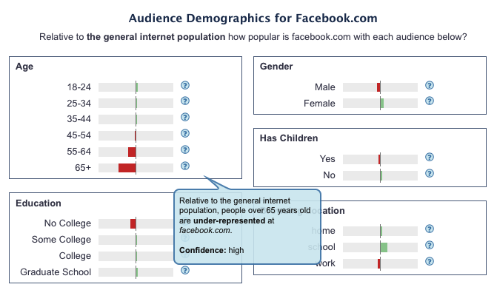
Source: alexa.com; 10/6/2010
Notes:
Note: Underepresented of internet population, which is underepresentative of older folks generally

Slide 7
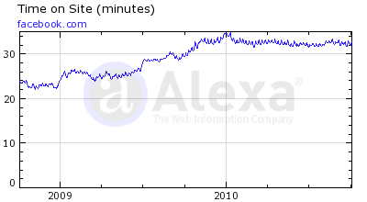
More than 30 minutes per visit.
Source: alexa.com; 10/6/2010
Notes:
Mashable
July 2010
Women 18-34
21% of women age 18-34 check Facebook in the middle of the night
63% use Facebook as a networking tool
42% think it’s okay to post photos of themselves intoxicated
79% are fine with kissing in photos
58% use Facebook to keep tabs on “frenemies”
50% are fine with being Facebook friends with complete strangers

Slide 8
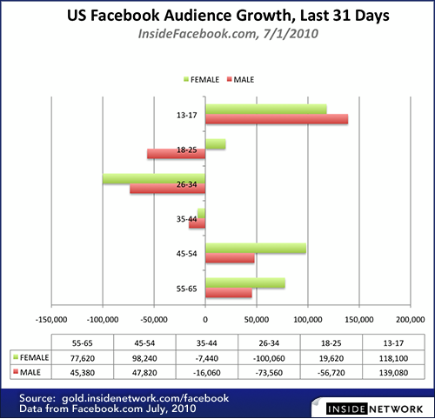

Slide 9
You only have to worry about these sites:

Slide 10


Slide 12
HAVE A POLICY.
Law 2:

Slide 13
Policy Provisions
Identify your role: if you’re talking about the company, make sure you identify yourself and your role.
Consider mandatory disclaimers.
Respect copyright and fair use laws.
Don’t refer to clients or individuals without their permission.
Don’t use language that would not be permitted at work.

Slide 14
Advanced Provisions
Who owns what employees write?
Who owns the list of “friends?”
How do you “back up” or retain your social networking information?
Does it fit into your records retention policy?

Slide 15
WRITE WHAT YOU WANT TO SEE AGAIN.
Law 3:

Slide 16
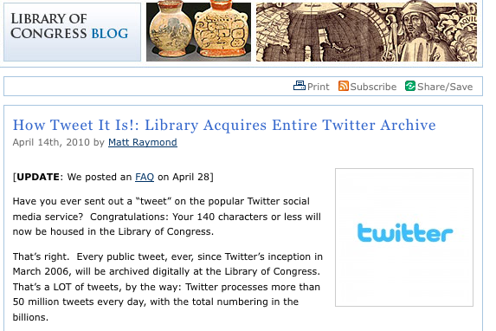

Slide 17
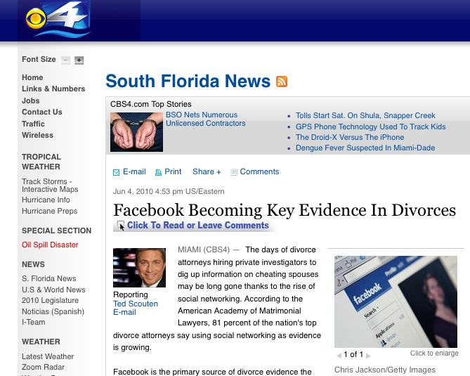

Slide 18
Make sure you CAN see it again.
Rule 4:

Slide 19
REMEMBER WHO You are dealing with.
Law 5:

Slide 20
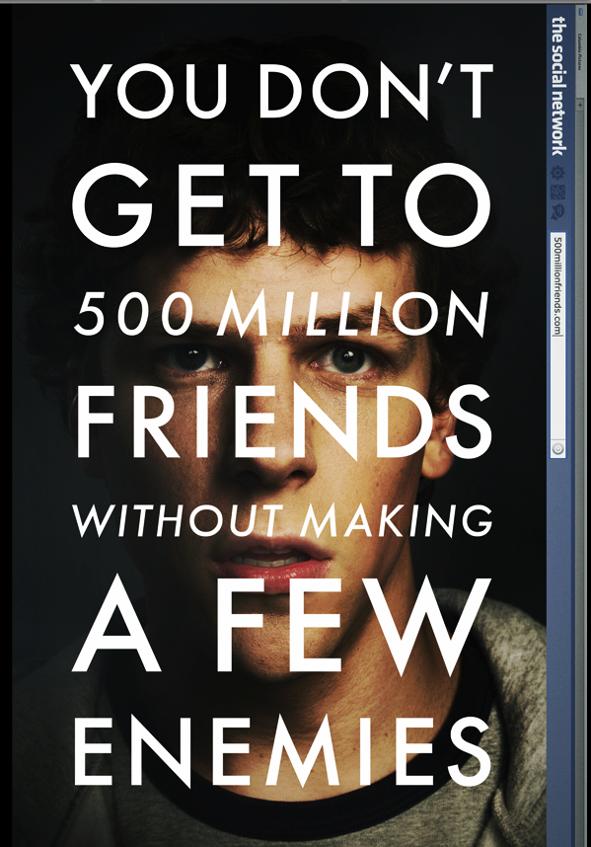

Slide 21
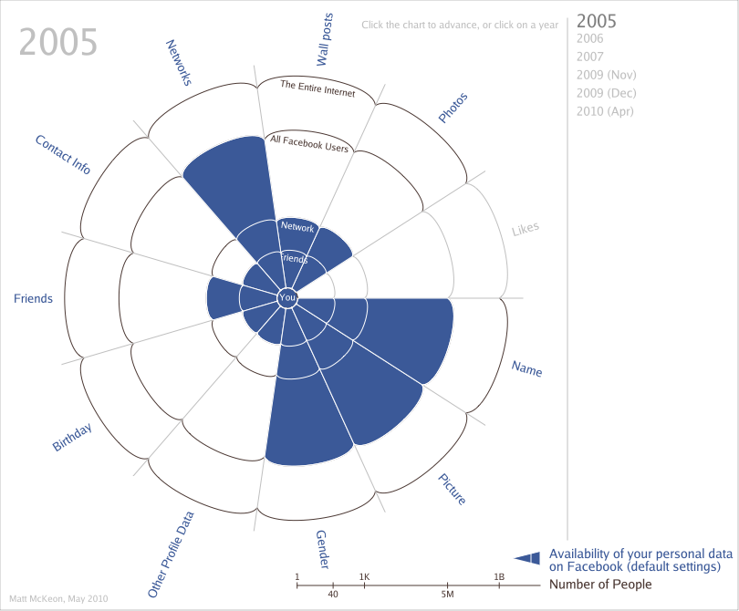

Slide 22
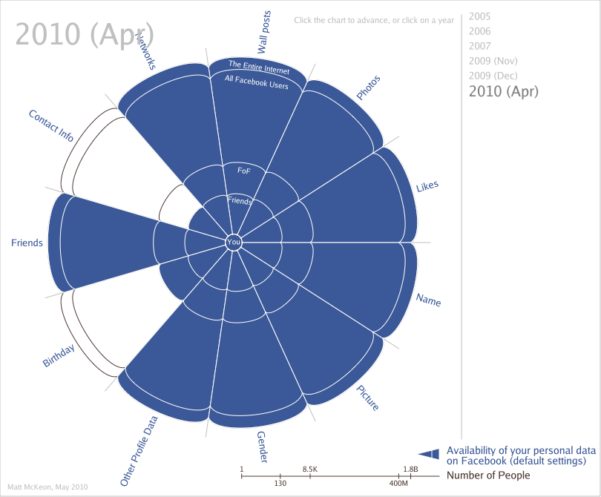
http://mattmckeon.com/facebook-privacy/

Slide 23

Zuck: Yeah so if you ever need info about anyone at Harvard
Zuck: Just ask.
Zuck: I have over 4,000 emails, pictures, addresses, SNS
[Redacted Friend's Name]: What? How'd you manage that one?
Zuck: People just submitted it.
Zuck: I don't know why.
Zuck: They "trust me"
Zuck: Dumb F***S.
Read more: http://www.businessinsider.com/well-these-new-zuckerberg-ims-wont-help-facebooks-privacy-problems-2010-5#ixzz0tyaiyUr4

Slide 24
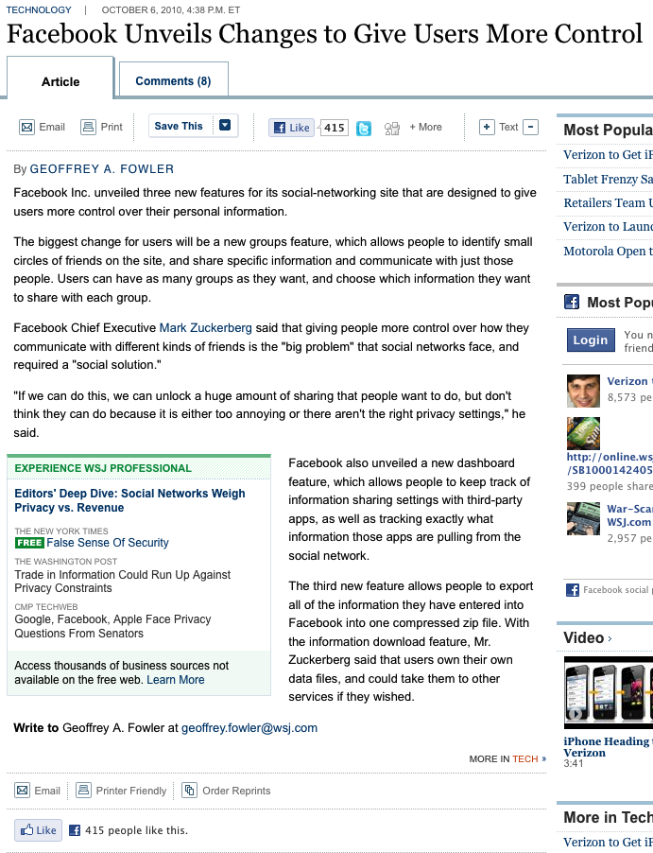
While you were sleeping

Slide 25
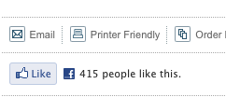
While you were sleeping

Slide 26
THOU SHALT REMEMBER THE Laws, Regulations AND ETHICS GOVERNING YOUR BUSINESS.
BONUS Law 6:

Slide 27
Government Actors
  First Amendment
  Including government schools
Legal
  Judges
  Testimonials (“like”)
Public Companies
  SEC/Insider information
Sports
  http://www.sportsbusinessdaily.com/article/132277 ($2500 fine for complaining about food at camp)
  Mark Cuban ($25K for complaining about refs; $100K for talking about LeBron James)

Slide 28
Chambers: May be subject to 501(c)(6) regulations, including private inurement doctrine.

